Slide 1




Slide 2
What is disambiguation?
Conversation is often about clarifying... someone says 'things are going well’ Did they get a raise? Did they get engaged? Divorced?
In AI this is caused because we have utterances that link/trigger to multiple intents referred to often as ‘overlapping intents'
WA has the ability to clarify when multiple nodes are triggered (conditions are evaluated as true).
Watson Assistant
Disambiguation
2

Slide 3
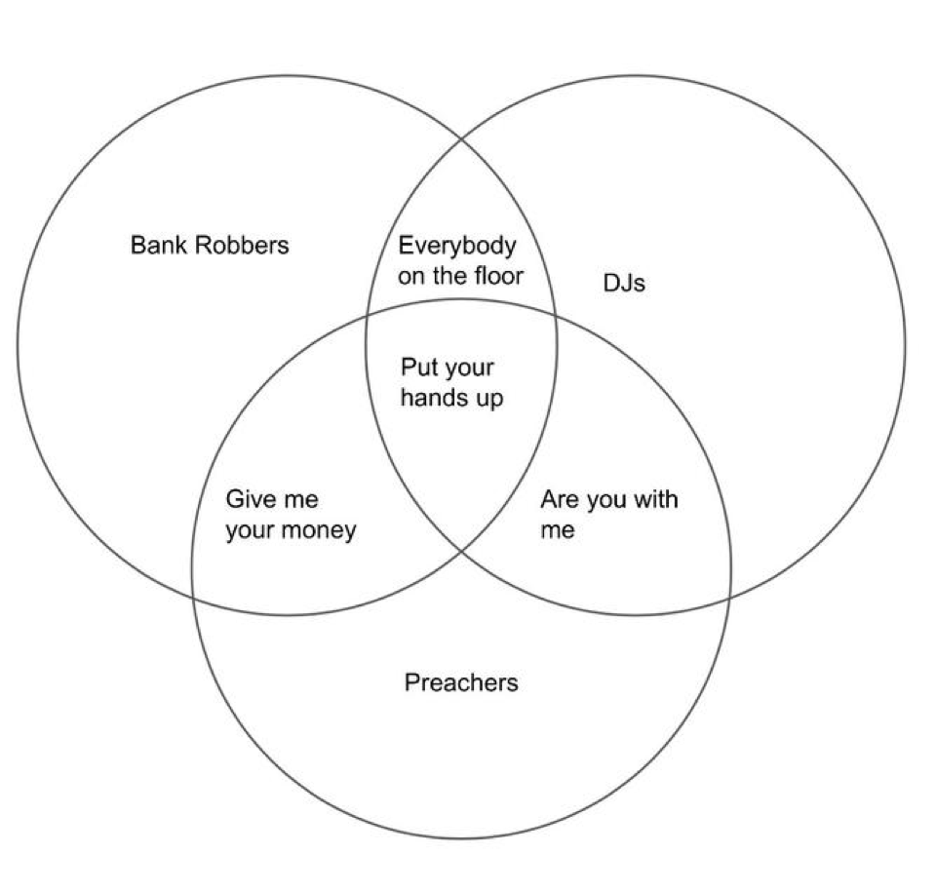
Disambiguation
Classic Example
‘Put my hands up’? Says who!?
3

Slide 4
“Cancel my
Savings-Account”
“Cancel my
Checking-Account”
Disambiguation
Banking Problem
“Cancel my Account”
“Cancel my
Credit Card”
4

Slide 5
Disambiguation must be turned on: From the Skill toolbar go to Options >>> Disambiguation, then Answer all the questions.
The node condition must be triggered/evaluated as true for the feature to activate.
The intent must score more than .2 (Disambiguation central functionality is comparing intent confidence. This means won’t work if your node triggers off just entities, variables or any set of conditions that don’t include intents or contain components that don’t evaluate as true)
The competing intent 55% or more of the top intent.
There must be text in the node's “external node name” field which is the absolute last field in each node.
How to Set It Up
5

Slide 6
How to reveal the intent confidence:
Add the following method to your response: <? intents ?>
How can this be used when there is a voice caller when disambiguation serves clickable options?
user can repeat the option utterance
user can repeat the number associated with the option
user can press a number on their phone
DTMF (Dual Tone Multi Frequency) is natively supported by voice gateway: https://www.ibm.com/support/knowledgecenter/SS4U29/api.html#action-tags
Can return a number to WA, just ned to train each intent what the correc
Link to complete details on Disambiguation in the IBM Docs:
https://cloud.ibm.com/docs/services/assistant?topic=assistant-dialog-runtime#dialog-runtime-disambiguation
Additional Considerations
6

Slide 7







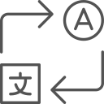

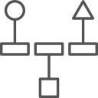


Watson Products
Watson Accelerators
Watson Expert Services
Watson Assistant
Voice of the Customer
Design
Watson Discovery
Tone Analyzer
Compare & Comply
Natural Language Understanding
Customer Care
Learn
Personality Insights
Plan
Expert Assist
Knowledge Studio
Build
Visual Recognition
Compliance Assist
Language Translator
Deploy
Speech-to-Text
Natural Language Classifier
On Demand Consulting
Text-to-Speech
+ Custom Engagements
Watson Explorer
7

